Slide 1
THE REPUBLIC OF SERBIA Ministry of Education, Science and Technological Development National WG for Referencing NQFS to EQF
Referencing to the EQF and self-certification to the QF-EHEA
Presentation of the Referencing Report
52th meeting of the EQF Advisory Group
Brussels, February 4th 2020.

Slide 2
Presentation content
Fulfilment of EQF criteria
Fulfilment of QF-EHEA criteria and procedures
Future development
Comments from EQF AG and updates - CEDEFOP, ETF

Slide 3
FULFILMENT OF EQF CRITERIA

Slide 4
The responsibilities and/or legal competence of all relevant national bodies involved in the referencing process are clearly determined and published by the competent authorities
Criterion 1

Slide 5
MoESTD is EQF NCP responsible for involving key bodies and institutions in referencing process noks.mpn.gov.rs
Inter-Ministerial Working Group, established by the MoESTD (2017.)
Government: ministries responsible for education, for labour and employment, for economy, for finance, for youth, for public administration and local self-government, Public Policy Secretariat, National Employment Service, Statistical Office of the Republic of Serbia;
Quality assurance institutions: education institutes, Commission for Accreditation and Quality Assurance in HE, national councils, Conference of Universities of Serbia, Conference of Academies of Applied Studies in Serbia;
Social partners: Serbian Chamber of Commerce, trade unions, employer associations.
Along with the development of the legislative framework, WG defined The plan of referencing activities based on the National Action Plan for the establishment and implementation of the NQFS and proposed bodies participating in the referencing process.
Notes:
Serbia started with preparation process for referencing at the end of 2016, and in 2017 Inter - ministerial group adopted document NQFS as the basis for establish Law and referencing process, in 2018 Ministry as NCP took over management of Referencing process. Plan of Activities was developed and National WG for Referencing NQFS to EQF was form

Slide 6
NQFS Institutional Framework
Institution | Key responsibilities
Ministry of Education, Science and Technological Development (MoESTD) | Monitoring the implementation of NQF law and coordination of institutions and bodies Adoption of Methodology for development of qualifications standards Adoption of qualification standards Adoption of standards for self-evaluation and external assessment of accredited adult education providers
NQFS Council (NQFSC) | Advising on the quality of the NQFS implementation and referencing to EQF Adoption of qualifications standards proposal Recommendation on SSC establishment Monitoring SSC operation
Qualifications Agency (QA) | Providing professional support to referencing process and implementation of NQFS Providing professional and technical support to NQFS Council and SSC Development of qualification standards proposals Management of the NQFS Register Accreditation of providers in Adult Education Recognition of foreign qualifications
Sectoral Skills Councils (SSC) | Decision making on initiatives for qualification standard development Mapping and identifying relevant qualifications within the Sector Identifies qualification that are outdated Proposes list of qualification that are suitable for RPL

Slide 7
Referencing process
ACTIVITIES
A working group was formed to produce the Report in accordance with the Action Plan of the Inter-Ministerial Working Group | Analysis and harmonization of the opinions of key quality assurance institutions
Brochure on referencing criteria based on the EU Guidelines was prepared | Presentations – Inter-ministerial Working Group, NQFS Council and Sector Skills Councils
Plan for carrying out the referencing process was adopted by the Minister | Integration of the consultation results and proposals for further activities and challenges into the Report
Data for the Report collected - analysis of documentation and consultations with MoESTD, QA, councils, institutes | Forwarding the Draft Report to the Council of Europe
Expert support (meetings and workshops), consultations with ETF | Presenting the Draft Report and referencing process at the Conference on NQFS in December 2019
Comments from relevant departments of the MoESTD collected | Finalizing the Report
Draft Referencing report prepared | Final evaluation by international experts
Delegation to present the first Draft Report nominated | Presenting the Report to the Advisory Group (FEBRUARY 2020)
Draft Report sent to key quality assurance institutions for their opinion (QA, IIE, IEQE, NEAQA) | Updating websites, promotion of the Report
 | Planning and initiation of activities in the system as a consequence of referencing NQFS to the EQF

Slide 8
There is a clear and demonstrable link between the qualifications levels in the national qualifications frameworks or systems and the level descriptors of the EQF
Criterion 2

Slide 9
Result of the Analysis
NQFS contains eight levels corresponding to the levels of the European Qualifications Framework
The structure of the NQFS is also designed in accordance with the EQF and includes descriptors for each (sub)level of qualification, based on the concept of learning outcomes
There is a correlation and compatibility between the language and the concepts descriptions of both framework levels
The NQFS contains specific attributes as a result of national context and legislation, so that statements of knowledge, skills, abilities and attitudes are aligned with the policy of defining learning outcomes, i.e. all are formulated as verbs
EQF | NQFS
1 | 1
2 | 2
3 | 3
4 | 4
5 | 5
6 | 6.1
 | 6.2
7 | 7.1
 | 7.2
8 | 8
Notes:
points of equivalence

Slide 10
Specific NQFS attributes
Two sublevels at level 6 and 7 as result of national context and stakeholders acceptance of qualifications in new framework
The skills descriptions in the NQFS have been extended to other aspects such as 'complexity of problems', 'communication', 'use of equipment’
Abilities and attitudes - apart from the main determinants (responsibility and autonomy) for description of outcomes per levels, contain other criteria, for example “demonstrating entrepreneurialism”
3, 4 and 5 are slightly demanding than EQF levels (international experts observation)

Slide 11
EQF LEVEL 2 | KNOWLEDGE Basic factual knowledge of a field of work or study | KNOWLEDGE Possesses general and vocational knowledge of facts and basic principles necessary for work and / or learning | NQFS LEVEL 2
 | SKILLS Basic cognitive and practical skills required to use relevant information in order to carry out tasks and to solve routine problems using simple rules and tools | SKILLS Applies the skills required to perform routine, pre-determined operational tasks; Handles tools and machines following detailed technical instructions using prescribed work materials
 | RESPONSIBILITY AND AUTONOMY Work or study under supervision with certain level of autonomy | ABILITIES AND ATTITUDES Performs tasks in accordance with established technical and technological procedures, with supervision; Is responsible for the implementation of established procedures, means and organisation of own work
EQF LEVEL 4 | KNOWLEDGE Factual and theoretical knowledge in broad contexts within a field of work or study | KNOWLEDGE Possesses systematised and theoretical knowledge required for work and / or learning | NQFS LEVEL 4
 | SKILLS A range of cognitive and practical skills required to generate solutions to specific problems in a field of work or study | SKILLS Applies the skills needed to perform complex, diverse, often non-standard tasks using different methods and techniques Performs selection of relevant information gathered from various sources for use in the work or learning; Handles various equipment, machinery and plants using different materials
 | RESPONSIBILITY AND AUTONOMY Exercise self-management within the guidelines of work or study contexts that are usually predictable, but are subject to change Supervise the routine work of others, taking some responsibility for the evaluation and improvement of work or study activities | ABILITIES AND ATTITUDES Performs tasks independently in accordance with technical and technological procedures; Organises and controls own work and / or small group work; Identifies problems and participates in solving them; Is responsible for choosing procedures and method of his own work, and for operative work of others

Slide 12
The national qualifications frameworks or systems and their qualifications are based on the principle and objective of learning outcomes and related to arrangements for validation of non-formal and informal learning and, where appropriate, to credit systems
Criterion 3

Slide 13
Key concepts in NQFS
Qualification is a formal recognition of the acquired competencies. An individual obtains a qualification when the competent body determines that he/she has achieved learning outcomes within a certain level and according to the determined qualification standard, which is confirmed by a public document (diploma or certificate).
Description of Learning outcomes is KEY ELEMENT of qualification standard.
Competency based education
A competence is an integrated set of related knowledge, skills, abilities and attitudes, which enables the individual to perform effectively in accordance with the qualification standard.
Qualification
Qualification standard
Learning outcomes
Learning outcomes are clear statements of what an individual is expected to know, understand and is able to demonstrate, i.e. do when the learning process is completed.

Slide 14
Qualification standard elements
QUALIFICATION STANDARD
Title of the qualification:
Code of the qualification
BASIC QUALIFICATION CHARACTERISTICS | RELEVANCE OF QUALIFICATION FOR EMPLOYMENT AND FURTHER LEARNING
CLASSNQFS / ISCED-F 2013 | Permeability within the qualifications system
NQFS LEVEL | Occupation(s) to which qualification is related
EQF level | Occupational standard^{[1]}
QF-EHEA cycle | Duties and tasks / only if there is no occupational standard
Field of education - HE qualifications
Field of work – VET qualifications
Type of the qualification | LEARNING OUTCOMES
Scope of the qualification (in credits or duration of programme) | General description of the qualification
Preconditions for the acquisition of the qualification | Knowledge
Form of learning/education | Skills
Type of public document | Abilities and attitudes
 | Type of assessment of the achievement of learning outcomes
QUALIFICATION STANDARD REFERENCE DATA | QUALIFICATION QUALITY ASSURANCE
Effective Date | Qualifications of programme organizers
Revision date | The body competent for issuing the document
End date
^{[1]} Article 50. paragraph 3. of the Law on NQFS stipulates that until the adoption of occupational standards in accordance with the regulations relevant to employment, the link between qualification standards and the labour market will be based on the data on occupations determined in accordance with labour and employment regulations.
Notes:
5 groups of data, established in standardized format and structure
Coorelation of OS and QS

Slide 15
Learning outcomes
Learning outcomes - an instrument for the process of standardisation in education, in terms of qualification and programme development and assessment procedures.
GE – standards of students’ achievement and standards of cross-curricular competencies (basis for curricula development, assessment and examinations)
VET – qualification standards on which curricula learning outcomes are based
HE – accreditation standards for the institutions (the description for the qualification in compliance with the Dublin Descriptors of learning outcomes) and accreditation of a study programme (description of learning outcomes as an obligatory element of the programme, as well as general and subject-specific competencies)

Slide 16
Learning outcomes in VET
Logistics and freight forwarding technician - Level 4
Vocational competencies | Knowledge | Skills | Abilities and attitudes
Upon the completion of the educational programme, the person shall be able to:
Organise freight transport | specify the types and explain the characteristics of the goods distinguish different types of packaging distinguish different types of transport and explain their characteristics explain the exploitation and technical characteristics of the means of transport specify and describe the transport routes explain the environmental protection measures | - select the type of vehicle - select the type of transport route - fill in the transportation documents - calculate and invoice the freight transport services - implement environmental protection measures | conscientiously, responsibly, properly and accurately perform entrusted tasks; effectively plan and organize time and set priorities; demonstrate a positive attitude towards the importance of implementing regulations and applicable traffic standards; display a positive attitude towards the functionality and operability of machines and devices used in the performance of the business; demonstrate kindness, communication skills, entrepreneurial spirit and flexibility in relation to associates and clients; problem solving at work;
Notes:
In this moment we have draft methodology in line descriptors../2017. standards based on old methodology, most of the learning outcomes were based on descriptors (knowledge, partially skills and abilities were blended

Slide 17
Credit System
ECTS is based on the principle that the sum of 60 ECTS points corresponds to the overall average student engagement during a 40-hour workweek in an academic year.
Student workload - about 1500-1800 hours per year - 1 ECTS credit is awarded for about 25-30 working hours.
The student workload expressed through ECTS credits implies the time required to complete learning activities: attending classes, seminars, consultations, independent research and learning, project preparation, exams, practical classes, etc.
Transfer of ECTS credits is possible between different study programs, within the same cycle and type of studies, while in international mobility programmes transfer of ECTS credits is possible also between different cycles and types of studies
Implementation of the system ECVET is foreseen in the Strategy, but neither decision nor regulation has been adopted.

Slide 18
VNFIL
RPL - an AE activity which is achieved through the assessment of knowledge, skills, abilities and attitudes acquired through education, life or work experience, which enables further learning and increases competitiveness in the labour market; the term is equated with the term VNFIL, in line with the European guidelines for validating non-formal and informal learning (NQFS Law)
2014. Concept of RPL
2019. with the IPA project support Concept is revised and in this moment bylaw on RPL is drafted
List of qualifications for RPL (levels 1-3 and 5) is proposed by SSC
CBA will be applied in process of recognition based on qualification standards
Notes:
the idea of revised concept and piloting is also to to set the credible system, so we can build trust…broaden validation in lifelong dimension

Slide 19
The procedures for inclusion of qualifications in the national qualifications framework or for describing the place of qualifications in the national qualification system are transparent
Criterion 4

Slide 20
Strategic course in NQFS development
establish reliable, transparent - assured process of qualification development
open the system for different interested parties
involve relevant actors in decision making
qualifications based on relevant data
support partnership on different levels
NQFS regulates procedures for qualifications identification, development and registration

Slide 21
NQFS Legislation framework
Secondary legislation
Standards of services of career guidance and counselling
(“Official Gazette RS”,
no. 43/19)
The NQFS Register
Methodology for development of qualification standards
Form and content of Initiative for development of qualification standard
Standards for self-assessment and external evaluation of providers od Adult education
The Law on NQFS
Qualifications framework:
qualification levels and descriptors, types of qualifications, qualifications classification system, available form of learning, career guidance and counselling
Bodies and institutions:
NQF Council, NQF Agency, Sector Skills Councils, Ministry responsible for education
Quality assurance:
qualification standard processes (Initiative for development, drafting the proposal and adoption of qualification standard) registration of the qualifications, referencing the NQF to EQF;
Recognition of foreign qualifications
Accreditation of providers of (non-formal) Adult Education

Slide 22
Procedure for inclusion of qualification in NQFS
Bodies
(councils)
Government institutions (Ministries, Agencies, Institutes)
Schools, Universities, Faculties, Private providers
Employers, Professional associations
Initiative for developing and adopting the qualifications standard
Elaborate justification of qualification and proposal of qualification standard
Qualification Agency
Assessment of the relevance of the Initiative
Sector Skill Council
Methodology of qualification standard development
Decision making on development of qualification standard
Qualification Agency
Development of qualification standard
Rulebook on NQFS Register
Rulebook on CLASSNQFS
NQFS Council
MoESTD
Qualification Agency
Adoption of qualification standard
Adoption
NQFS Register

Slide 23
NQFS Register Structure
Sub-registers | Content - data
National Qualifications | New qualifications Active qualifications: - level NQFS 1 - qualifications on level 2 NQFS from 1992/1993 - levels 3 to 5 NQFS from 2005/2006 - levels 6.1 to 8 NQFS from Bologna process introduction Register has Archive which contains qualifications made before active qualifications, because they are mostly represented in working population
Qualification standards | Standards of qualifications - defined by Methodology of Q development
Publicly Recognized Organizers of Adult Education Activities (PROAEA) | Accredited PROAEA - approved adult education programs/activities and employers with whom PROAEA realize practical work.

Slide 24
The national quality assurance system(s) for education and training refer(s) to the national qualifications frameworks or systems and are consistent with the principles on quality assurance as specified in Annex IV to this recommendation
Criterion 5

Slide 25
Quality assurance in GE – VET - AE
STANDARD | PROCESS | COMPETENT INSTITUTIONS / BODIES
student achievements | assessment in school Final exam and Matura exam national assessments | primary and secondary school Institute for the Improvement of Education Institute for Education Quality and Evaluation
quality of institution | external evaluation self-evaluation | Ministry of Education, Science and Technological Development Institute for Education Quality and Evaluation primary and secondary school
quality of educational programme | development of programmes GE programme accreditation VET programme accreditation adoption of programmes AE programme accreditation | Institute for the Improvement of Education National Education Council Council for Vocational Education and Adult Education Ministry of Education, Science and Technological Development Qualification Agency
textbook quality | textbook approval at the national level | Institute for the Improvement of Education National Education Council Council for Vocational Education and Adult Education Ministry of Education, Science and Technological Development
competencies of teachers | teachers’ licencing accreditation of professional development programmes for teacher | Ministry of Education, Science and Technological Development Institute for the Improvement of Education
competencies of headmasters | headmasters’ licencing professional development programmes for headmasters | Ministry of Education, Science and Technological Development Institute for the Improvement of Education Institute for Education Quality and Evaluation
quality of PROAEA | external evaluation self-evaluation | Qualification Agency PROAEA
qualification | development adoption | Sector Skill Councils Qualification Agency NQFS Council Ministry of Education, Science and Technological Development

Slide 26
Quality assurance in HE
STANDARD | PROCESS | COMPETENT INSTITUTIONS/ BODIES
qualification | development adoption | Qualifications Agency Sector skills council NQFS Council Ministry of Education, Science and Technological Development
programmes | accreditation of programmes and higher education institutions issuing a work permit | National Council for Higher Education (standards) National Entity for Accreditation and Quality Assurance Ministry of Education, Science and Technological Development
student achievements / certification | grading final thesis | Higher education institution
quality of work of the institution | external evaluation self-evaluation | National Entity for Accreditation and Quality Assurance Higher education institution

Slide 27
Coverage of the EQF QA principles in NQFS GE - VET - AE
EQF RECOMMENDATION 2017 ANNEX IV | Q Agency | NQFRS Council | Sector Skills Council | MoESTD | NEC | CVEAE | IIE | IEQE | School/ PROAEA
1. Design of qualifications and LO application | x | x | x | x | x | x | x | x | x
2. Valid and reliable assessment |  |  |  |  |  |  | x | x | x
3. Feedback mechanisms and procedures for continuous improvement | x |  |  | x |  |  |  |  | x
4. Involvement all relevant stakeholders at all stages of the process | x | x | x | x | x | x | x | x | x
5. Self-assessment and external review | x |  |  | x |  |  | x |  | x
6. Integration into management structures | x |  |  | x | x |  |  |  | x
7. Clear, measurable objectives and standards | x | x | x | x | x | x | x | x | x
8. Appropriate resources | x | x | x | x | x | x | x | x | x
9. Regular review of bodies / agencies, responsible for QA | x | x | x | x | x | x | x | x | x
10. Electronic accessibility of evaluation results | x |  |  | x |  |  |  |  | x

Slide 28
Coverage of the EQF QA principles in NQFS HE
EQF RECOMMENDATION 2017 ANNEX IV | Q Agency | NQFRS Council | Sector Skills Council | MoESTD | NCHE | NEAQA | HEI
1. Design of qualifications and LO application | x | x | x | x | x | x | x
2. Valid and reliable assessment |  |  |  |  |  | x | x
3. Feedback mechanisms and procedures for continuous improvement | x |  |  | x |  | x | x
4. Involvement all relevant stakeholders at all stages of the process | x | x | x | x | x | x | x
5. Self-assessment and external review |  |  |  | x |  | x | x
6. Integration into management structures | x |  |  | x |  | x | x
7. Clear, measurable objectives and standards | x | x | x | x | x | x | x
8. Appropriate resources | x | x | x | x | x | x | x
9. Regular review of bodies / agencies, responsible for QA | x |  |  | x |  | x | x
10. Electronic accessibility of evaluation results |  |  |  |  |  | x | x

Slide 29
The referencing process shall include the stated agreement of the relevant quality assurance bodies that the referencing report is consistent with the relevant national quality assurance arrangements, provisions and practice
Criterion 6

Slide 30
QA bodies approvals
Body | IEQE | IIE | NEAQA | QA | NCHE | NCE | CVEAE | MoESTD
Key QA responsibility | final exam in primary education state matura exam national assessments external evaluation of schools | programme development final and VET matura exam | accreditation of programmes and HEI external evaluation of HEI | development of qualification standards external evaluation of PROAEA | standards for accreditation of HEI | GE programme accreditation | VET programme accreditation | adoption of qualification standards work permit for HEI verification of schools GE and VET programme adoption

Slide 31
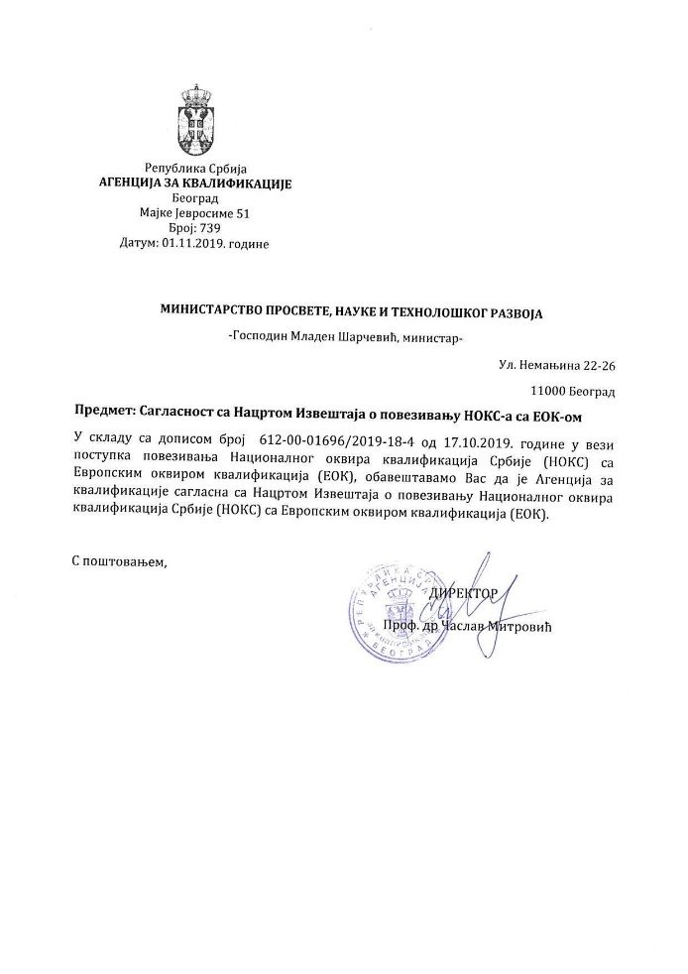
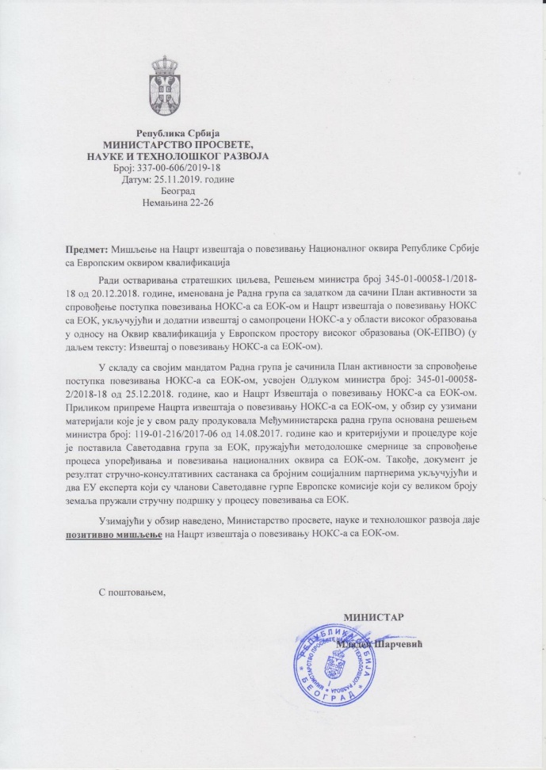
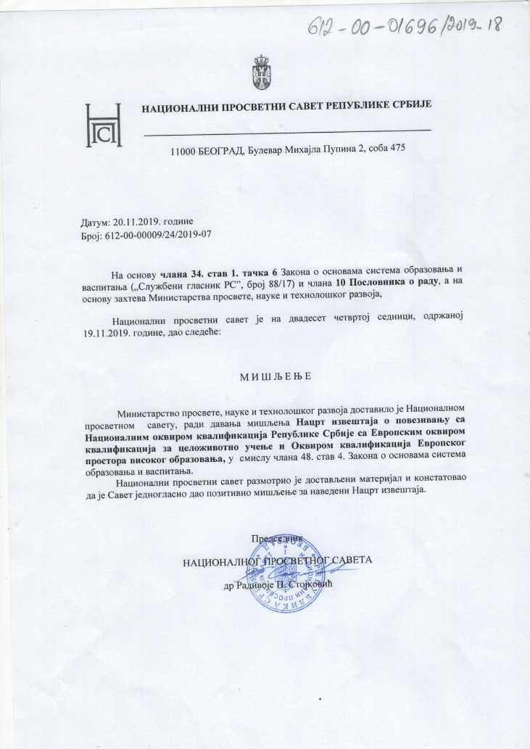
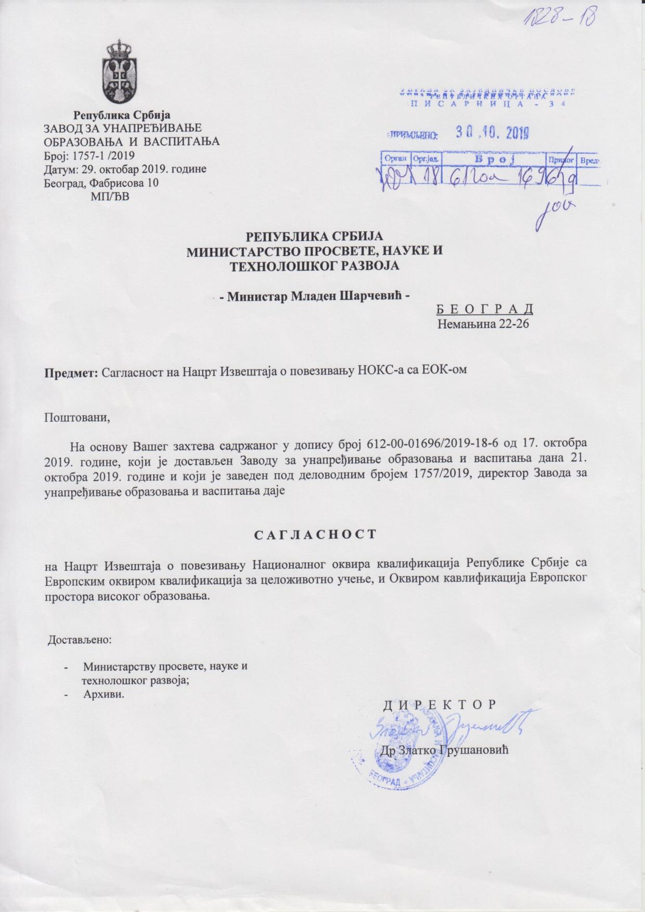
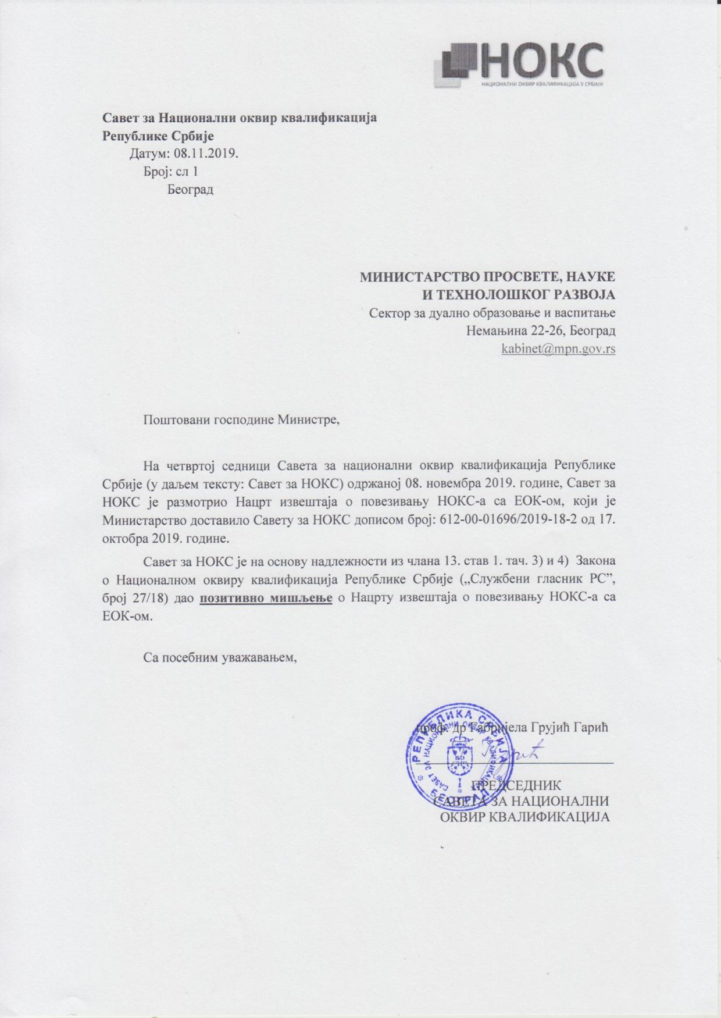
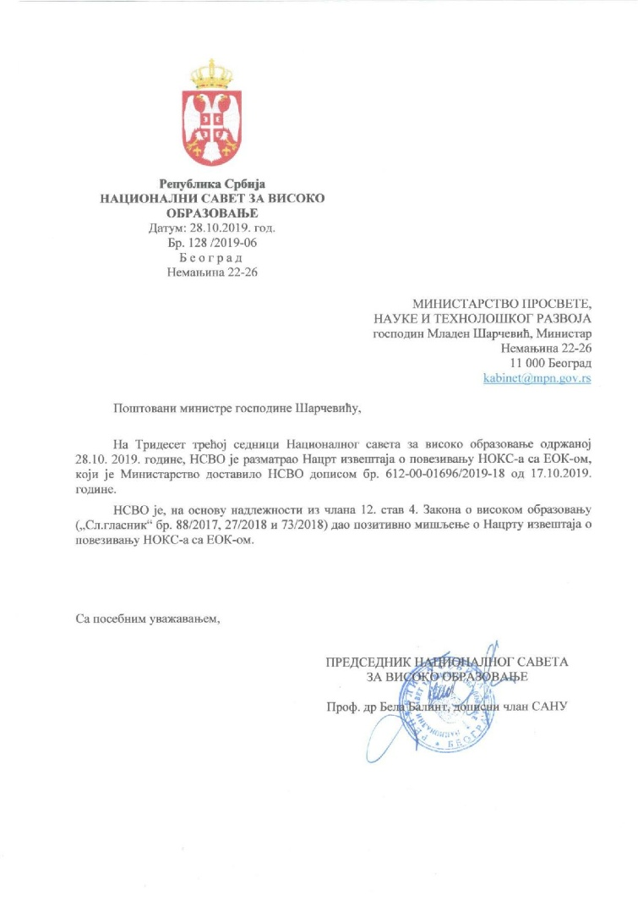
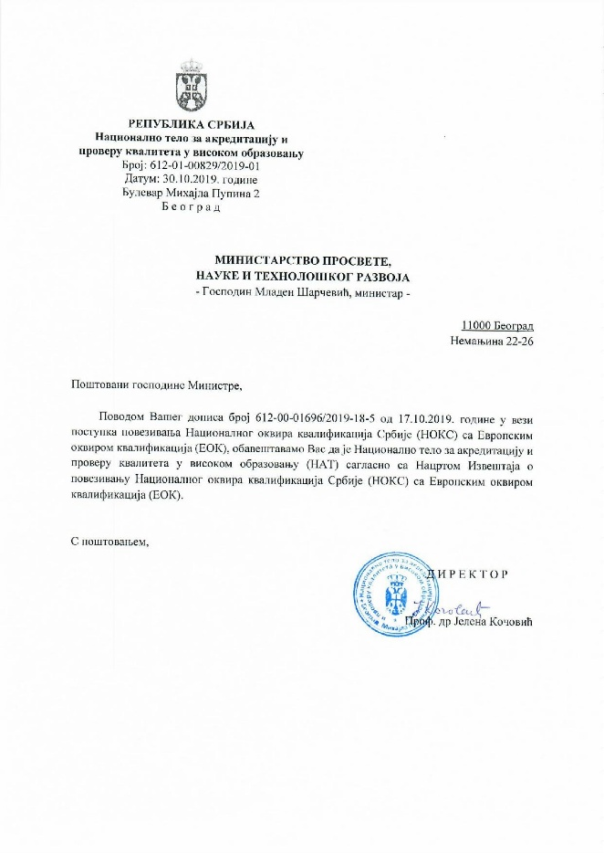
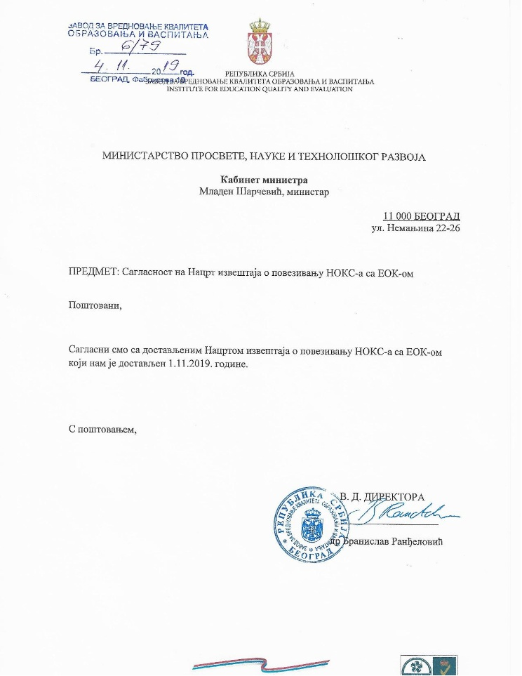
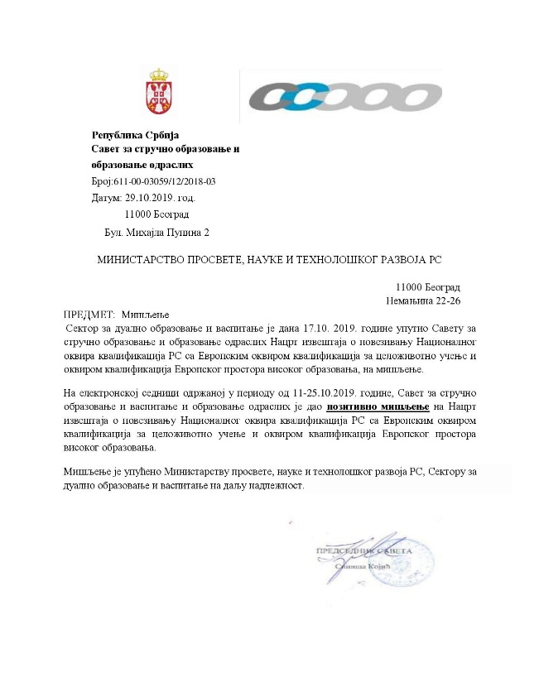
Criterion 6

Slide 32
The referencing process shall involve international experts and the referencing reports shall contain the written statement of at least two international experts from two different countries on the referencing process
Criterion 7

Slide 33
International Experts
Professor Mile Dželalija, PhD member of the EQF AG of the EU Commission, National Correspondents for the QF-EHEA of the Council of Europe, Cross-Sectoral Reference Group of the ESCO etc. He has actively participated in the implementation of NQFS in many countries (Serbia, Croatia, Austria, Greece, Montenegro, Poland, Turkey etc.), as well as provided professional support and assistance in drawing up reports on referencing NQF to the EQF (Croatia, Greece, Montenegro).
Eduard Staudecker member of the EQF AG of the European Commission, EUROPASS AG, Advisory Committee for VET, the CEDEFOP governing board and member of the ECVET users’ group at European level etc. In recent past he had the role of an international expert for the implementation of qualifications frameworks in numerous countries (e.g. Poland, Luxemburg, Croatia, Finland, Montenegro).
Providing expert support in the preparation of the Report on referencing the NQFS to the EQF and in applying methodological guidelines for conducting the process of comparing and referencing national frameworks to the EQF Holding working meetings and workshops with national experts Preparing comments and recommendations on the Draft Report on Referencing the NQF to the EQF Giving final assessment of the Referencing Report Support on reviewing NQFS descriptors

Slide 34
International experts opinions
Mile Dželalija: „In my opinion, this referencing report gives enough evidence to confirm the relationship between the NQFS and the EQF, and the QF-EHEA. The report is consistent with the EQF AG guidance on the referencing reports. For the international users it gives many details on the qualifications systems and thus, better understanding of the system. The report demonstrates the great efforts that have been done by experts from relevant national institutions and their social partners in Serbia, which makes a platform for sustainable implementation of the NQFS.“
Eduard Staudacker: „The report on referencing the Serbian qualifications framework (NQFS) to the European Qualifications Framework gives a clear and comprehensive view on the existing qualifications system and the modernizing and reform processes that are going on in Serbia. The report can be seen as the “sukkus” of political and conceptual work of the last years and proves the willingness and readiness of Serbia to create a modern and competitive qualifications system. ... it should be noted that from an external viewpoint the main demands concerning the link of the Serbian qualifications framework to the EQF have been met. The framework gives a transparent view of the system of qualifications, provides the foundation for validation, is a model for lifelong learning and makes the political reform processes visible“.

Slide 35
The competent authority or authorities shall certify the referencing of the national qualifications frameworks or systems with the EQF. One comprehensive report, setting out the referencing, and the evidence supporting it, shall be published by the competent authorities, including the EQF National Coordination Points, and shall address separately each of the criteria. The same report can be used for self-certification to the Qualifications Framework of the European Higher Education Area, in accordance with the self-certification criteria of the latter
Criterion 8

Slide 36
Criterion 8
This Report has been prepared and drawn up after consultations have been conducted and consents of all the relevant and competent national bodies obtained, and it represents a Comprehensive Referencing and Self-Certification Report of the NQFS to the EQF, and of the NQFS to QF-EHEA according to all the criteria of the EQF and QF-EHEA with supporting evidence.
It covers the latest state of development of the NQFS. The Referencing report will be published on the NCP website.

Slide 37
Within 6 months from having referenced or updated the referencing report, Member States and other participating countries shall publish the referencing report and provide relevant information for comparison purposes on the relevant European portal
Criterion 9

Slide 38
Criterion 9
The report about the Serbian EQF referencing process will be sent to the European Commission. The link to the publication on the NCP website will also be made available.

Slide 39
Further to the referencing process, all newly issued documents related to qualifications that are part of the national qualifications frameworks or systems (e.g. certificates, diplomas, certificate supplements, diploma supplements) and/or qualification registers issued by the competent authorities should contain a clear reference, by way of national qualifications frameworks or systems, to the appropriate EQF level
Criterion 10

Slide 40
Criterion 10
The MoESTD shall, upon the publication of the Report, undertake activities in its competence to ensure that all public documents related to the acquired qualification level contain referencing obtained in the NQFS and the EQF, i.e. QF-EHEA. Furthermore, the data on referencing the NQFS to the EQF or QF-EHEA shall be entered into qualifications in the NQFS Register.

Slide 41
FULFILMENT OF QF-EHEA CRITERIA AND PROCEDURES

Slide 42
Criterion 1
The national framework for higher education qualifications and the body or bodies responsible for its development are designated by the national ministry with responsibility for higher education
The responsibility of NQFS development as a whole, including the domain of qualifications attained in higher education, belongs to the Ministry of Education, Science, and Technological development, which, through the resolute cooperation, supervised and managed the work of many different working groups, official bodies and/or stakeholders during this process

Slide 43
Criterion 2
There is a clear and demonstrable link between the qualifications in the national framework and the cycle qualification descriptors of the European framework

Slide 44
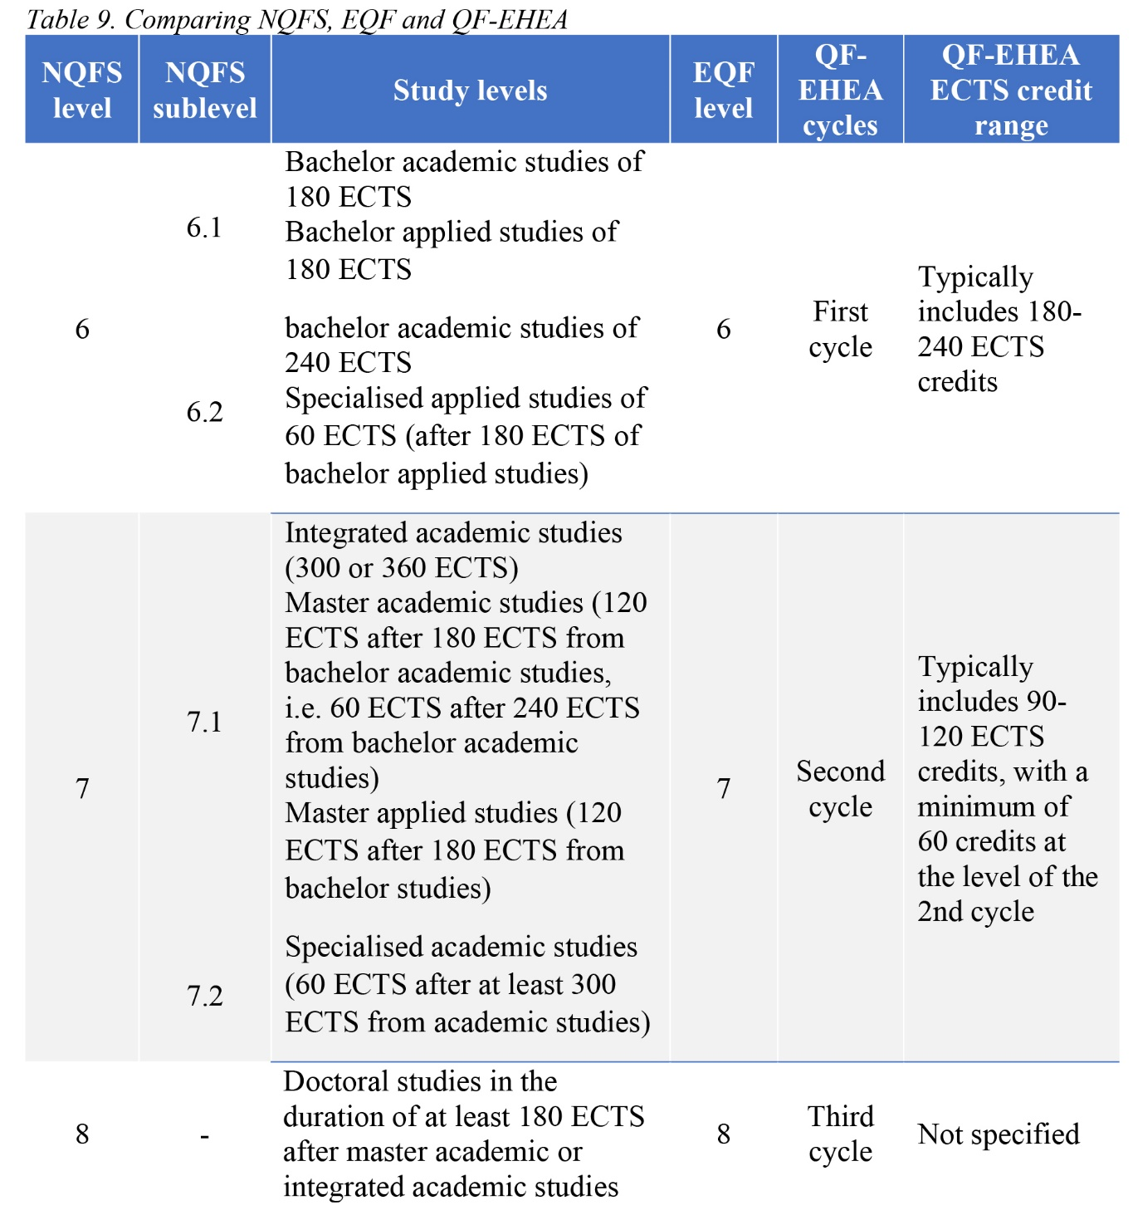
Comparison of NQFS, EQF and QF-EHEA by structure

Slide 45
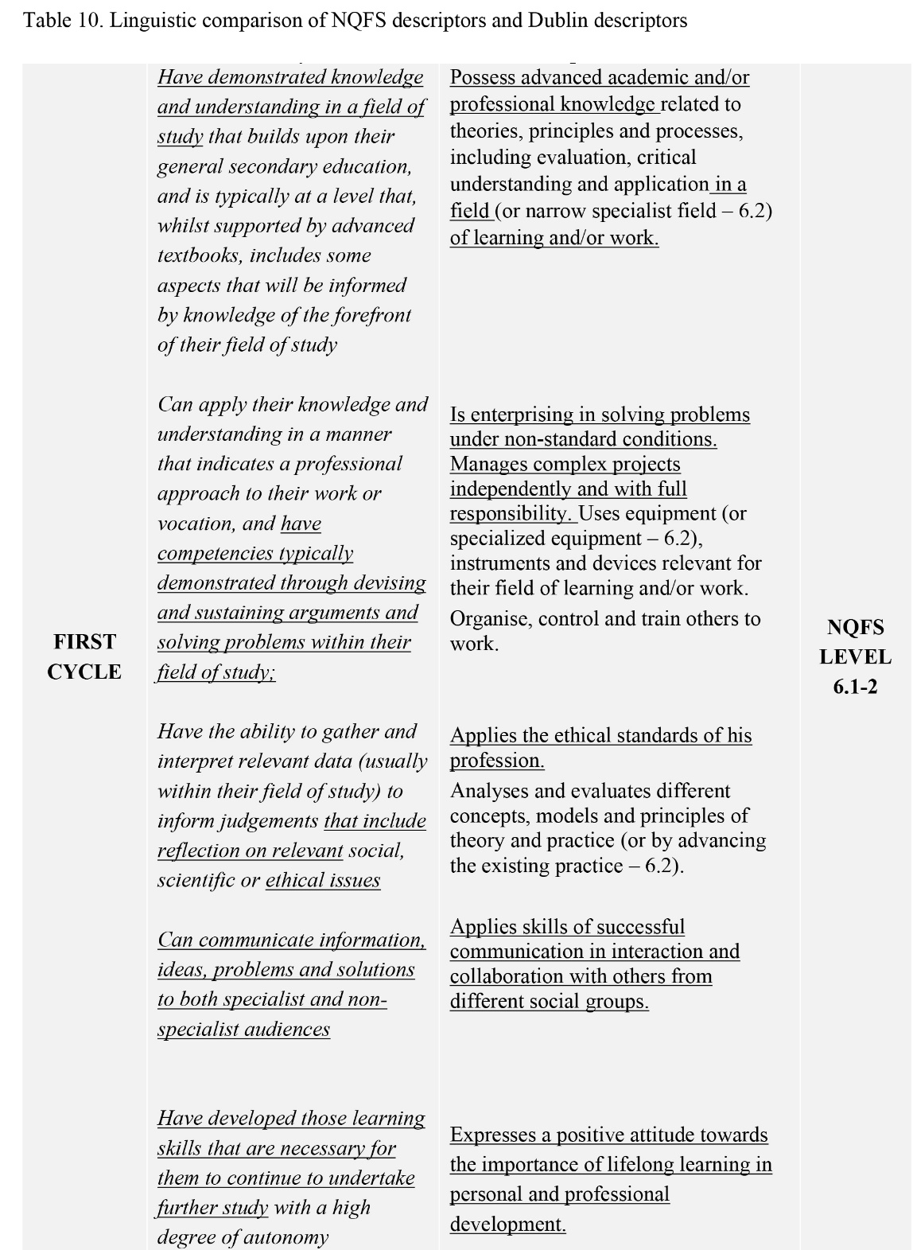
Linguistic comparison of NQFS descriptors and Dublin descriptors

Slide 46
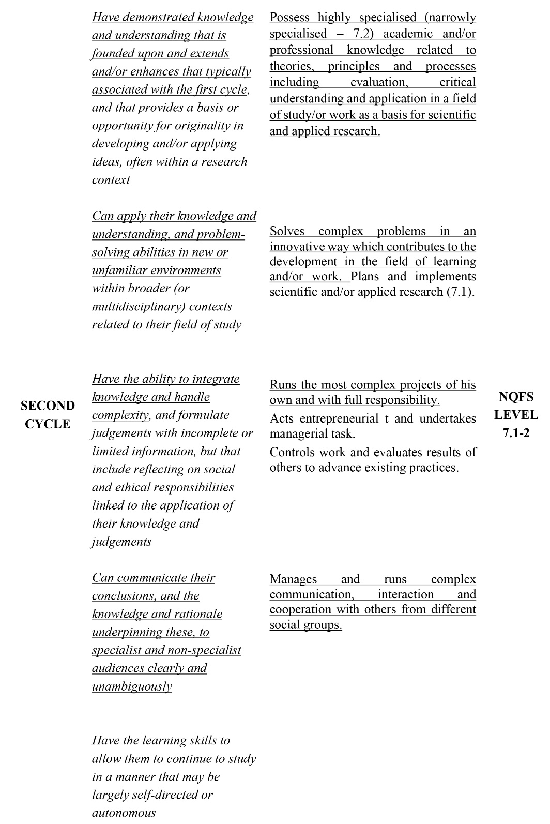
Linguistic comparison of NQFS descriptors and Dublin descriptors

Slide 47
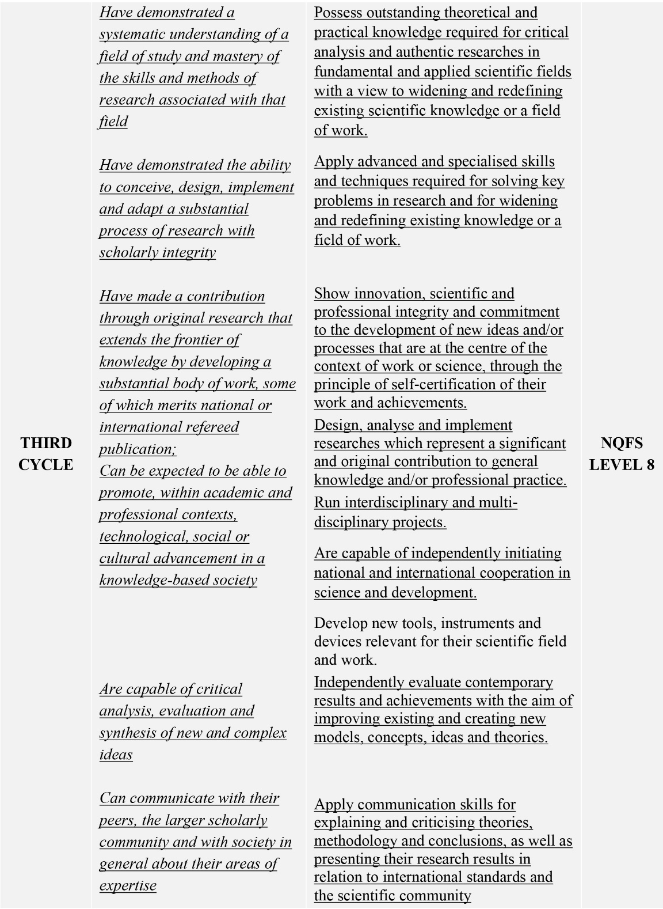
Linguistic comparison of NQFS descriptors and Dublin descriptors

Slide 48
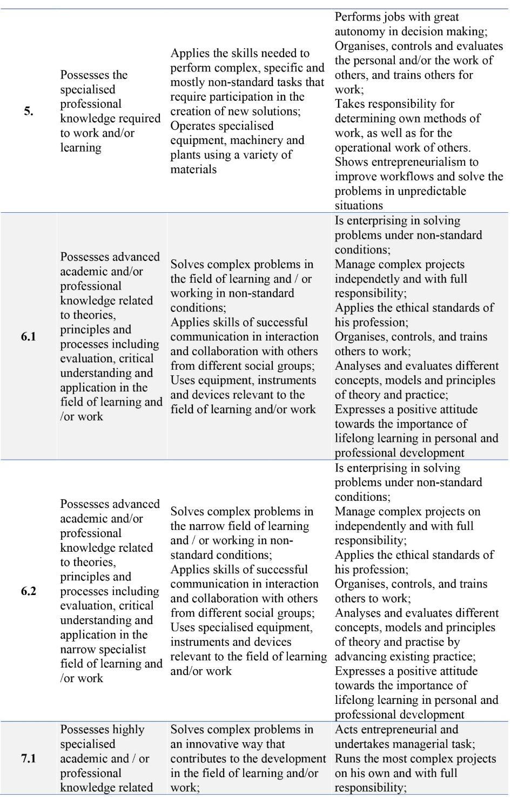

Slide 49
The Law on NQFS
II QUALIFICATIONS FRAMEWORK
Qualification levels
Article 5
Qualifications in NQFS are classified into eight (8) levels and four (4) sublevels

Slide 50
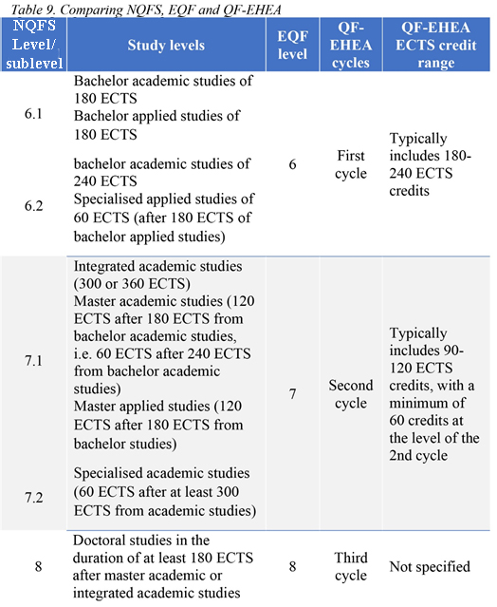

Slide 52
Posses advanced academic and/or professional knowledge related to theories, principles and processes, including evaluation, critical understanding and application: in a field of learning and/or work (sublevel 6.1) or narrow specialist field (sublevel 6.2).

Slide 53
Criterion 3
The national framework and its qualifications are demonstrable based on learning outcomes and the qualifications are correlated through ECTS

Slide 55
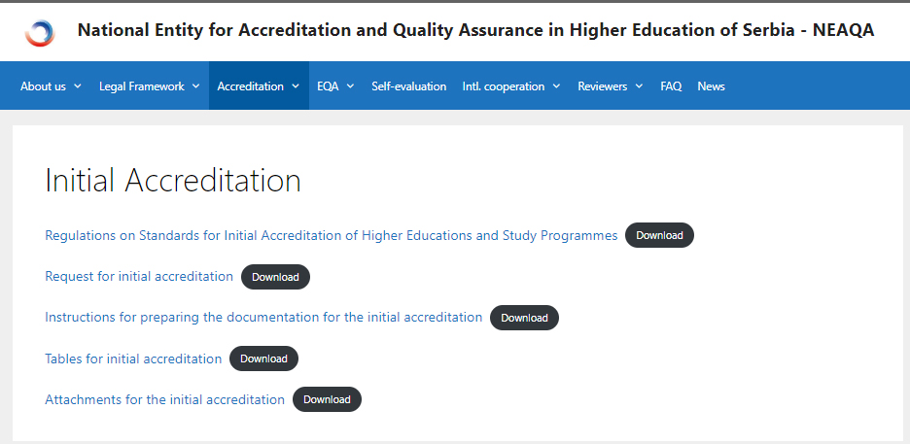

Slide 56
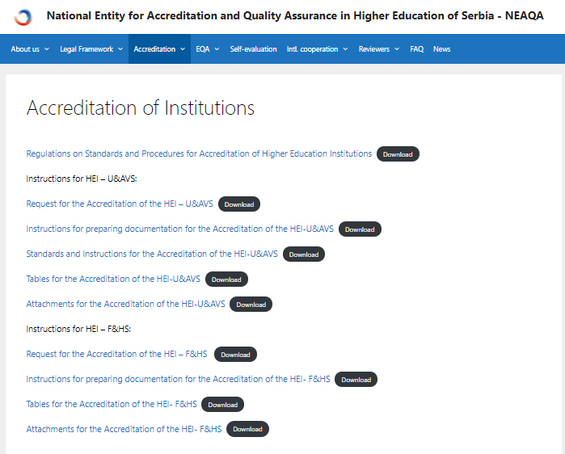

Slide 57
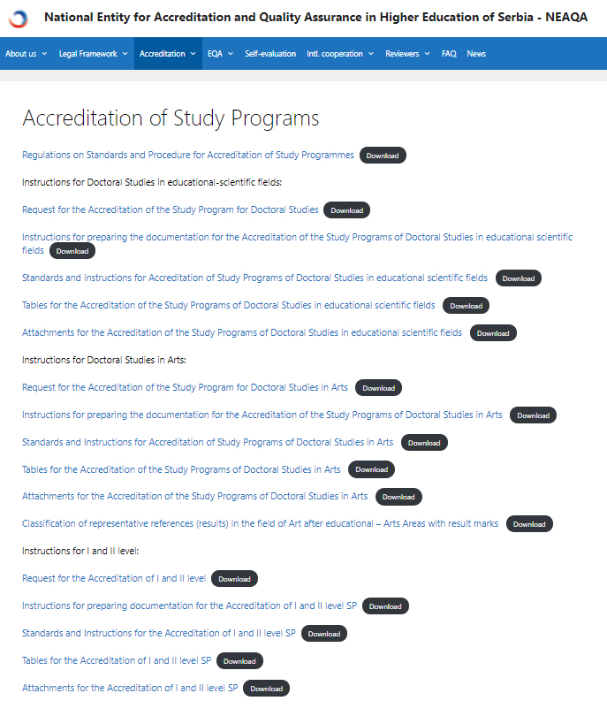

Slide 58
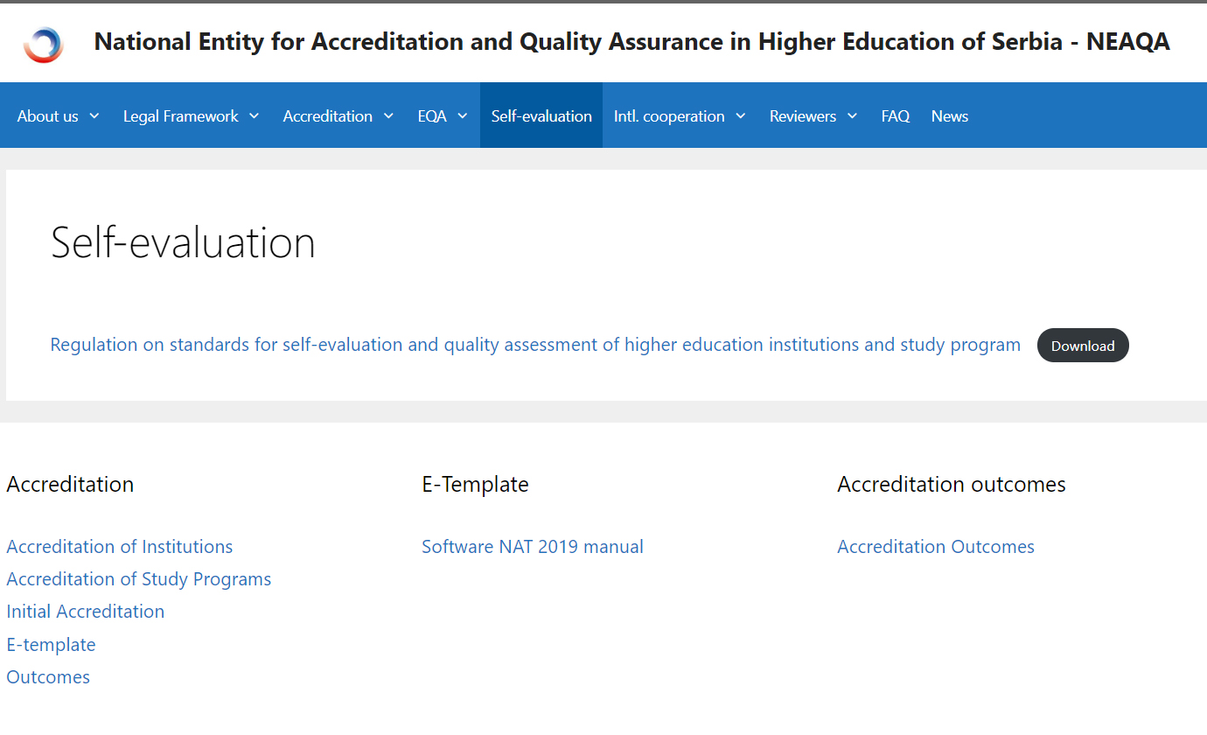

Slide 59
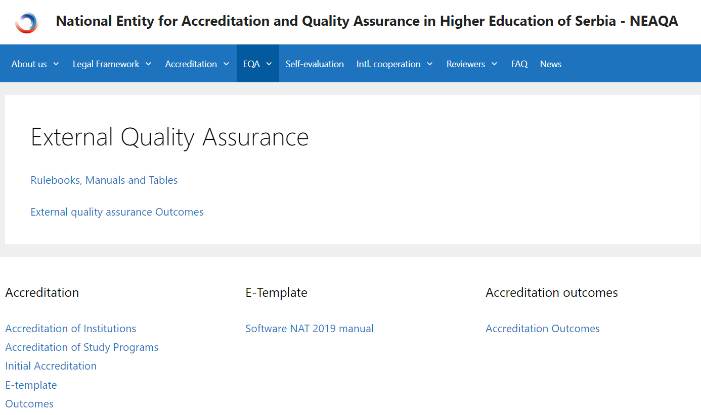

Slide 60
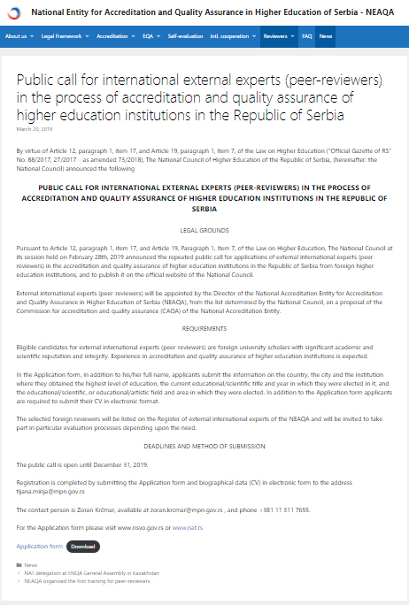

Slide 61
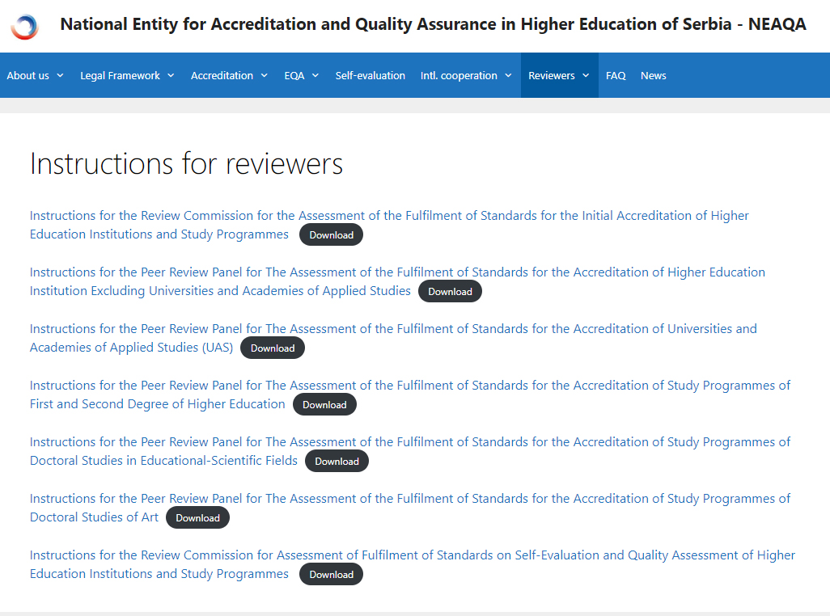

Slide 62
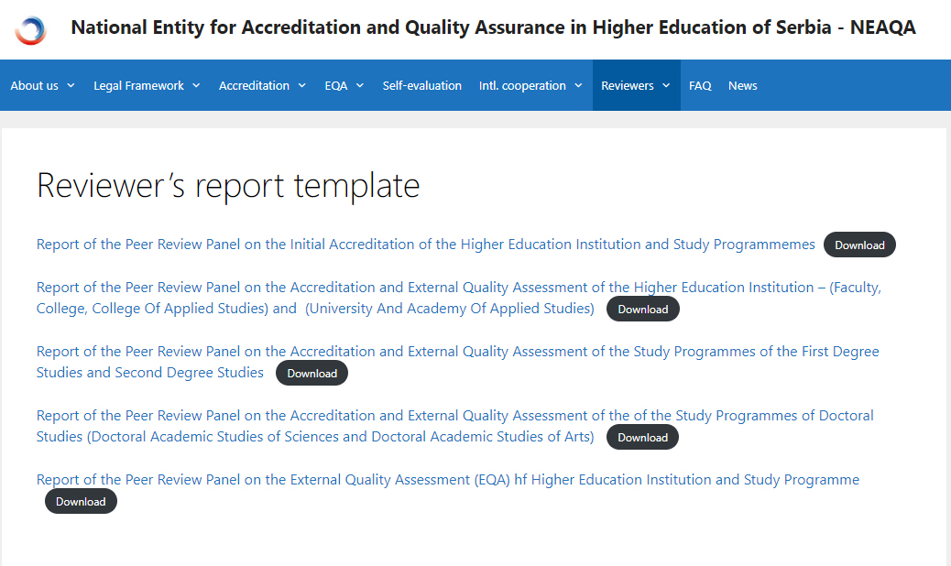

Slide 63
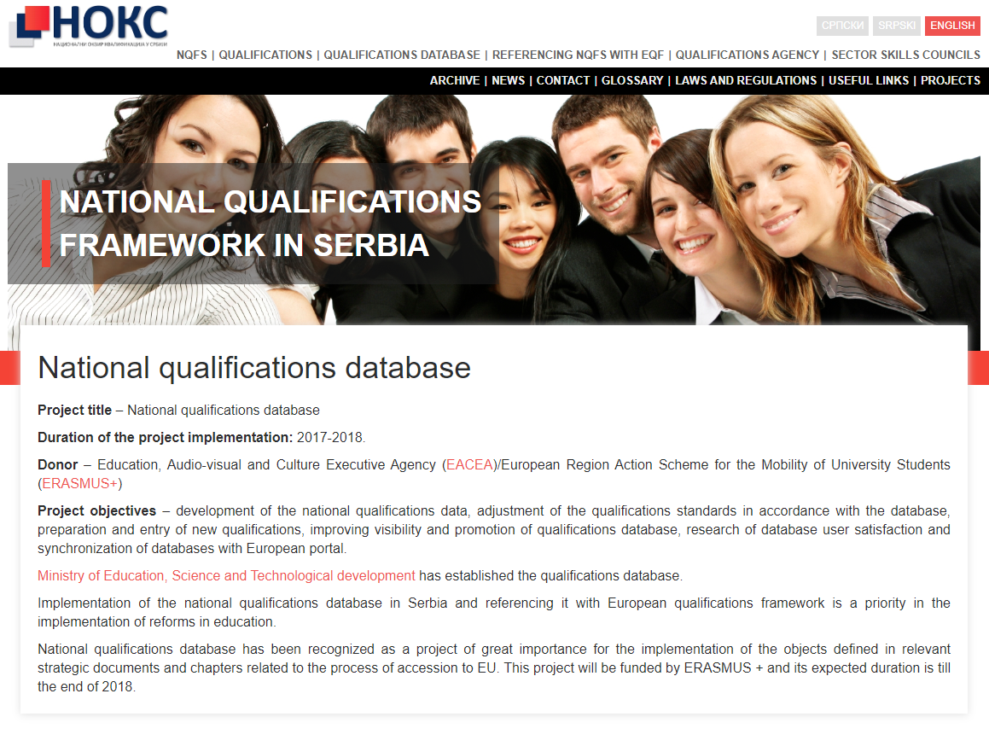

Slide 64
Master in Biology, 7.1 (300 ECTS)
By mastering the study program, the student is able to:
analyze structure, organization and function of biological systems at the level of molecules, cells, individuals and populations;
integrate previously acquired knowledge from other scientific disciplines in the processes of building and reorganizing his own knowledge system;
critically define and analyze scientific principles and principles in the chosen field of biology;
implement complex and specific research methods and techniques in biology;
solve unknown research problems by applying adequate scientific methods and procedures;
be responsible, independent and teamwork in a multidisciplinary environment;
be ready for continuous professional development;
be able to express/advocate bioethical standards;
be able to collect and interpret relevant information from professional and scientific literature in biological science;
be able to apply information and communication technologies in the field of biology.

Slide 65
Criterion 4
Procedures for inclusion of qualifications in the national framework are transparent
Qualification standard development
QA and SC
Accreditation
NEAQA/CAQA
Register of Qualifications
(QA)
New HE Qualification
Qualification does not exist yet
Register of Qualifications
Standards (QA)
Active HE Qualification
Accreditation
NEAQA/CAQA
Register of Qualifications
(QA)

Slide 66
Criterion 5
The national quality assurances systems for higher education refer to the national framework of qualifications and are consistent with the Berlin Communiqué and any subsequent communiqué agreed by ministers in the Bologna process

Slide 67
European standards and guidelines for quality assurance in the European Higher Education Area developed by the European Association for Quality Assurance in Higher Education (ENQA) have been used as a basis of the system of quality assurance of higher education in the Republic of Serbia
In 2007 the Commission for Accreditation and Quality Assurance in Higher Education became an associate member of ENQA
In 2011 CAQA sent an official request for external evaluation to be carried out by ENQA
In 2013 CAQA prepared the first report on self-evaluation
Based on these initiatives, in 2013 CAQA became a member of ENQA, and in 2014 a member of the European Quality Assurance Register for Higher Education (EQAR)
In 2017 CAQA prepared a report on self-evaluation with the aim of renewing membership in ENQA
Based on it, the decision was made to extend the membership of CAQA in ENQA for two years in under review status, in order to overcome the perceived shortcomings
In that sense, ENQA recommends that certain shortcomings in the system of external evaluation of higher education institutions be overcome, primarily in terms of involvement of experts who are not members of CAQA at the same time, so that CAQA is ensured financial independence in its functioning

Slide 68
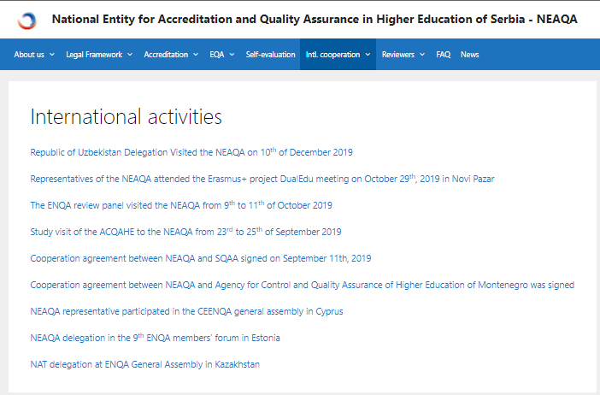

Slide 70
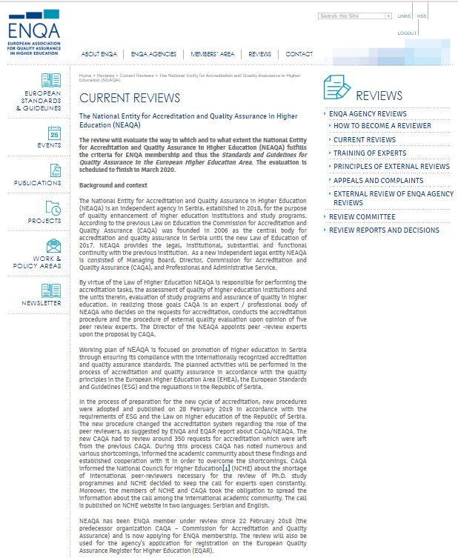

Slide 71
Criterion 6
The national framework, and any alignment with the European framework, is referenced in all Diploma Supplements
After the report will be published, MoESTD will change Rulebook on the public document in higher education

Slide 72
Procedure 1
The competent national body/bodies shall certify the national framework to the European framework
Procedure 2
The self-certification process shall include the stated agreement of the quality assurance bodies in the country in question recognized through the Bologna Process

Slide 73
Procedure 3
The self-certification process shall involve international experts
Procedure 4
The self-certification and the evidence supporting it shall be published. Each described criterion is treated separately

Slide 74
Procedure 5
The ENIC and NARIC networks shall maintain a public listing of States that have confirmed that they have completed the self-certification process
Procedure 6
The completion of the self-certification process shall be noted on Diploma Supplements issued subsequently by showing the link between the national framework and the European framework

Slide 75
FUTURE DEVELOPMENT

Slide 76
Ensure NQFS reform potential and sustainability in new Strategy for Education Development in Serbia by 2030
Improve policies on permeability/mobility within Higher Education and VNIFL
Manage the synchronization of processes of qualification standard and occupational standard development
Capacity building of new institutions, bodies and stakeholders – project support expended to Higher Education and Non-formal and informal learning
Notes:
Section for Life Long Learning and human capital development

Slide 77
COMMENTS FROM EQF AG AND UPDATES –CEDEFOP, ETF

Slide 78
Comments from minutes 51st AG meeting
More information about newly established bodies and to what extent are operational
Qualification Agency - operational from spring 2019, started all the activities on qualification development in line with NQFS Law, supported by IPA 2014 “Development of integrated NQF system in Serbia” 12 Sector Skill Councils started activities in November 2019 (rules of procedure, management, work plan, trainings), mapping qualifications of all levels and types NQFS Council started activities in autumn 2018, planning activities on monitoring implementation of NQFS, proposed establishment of 12 Sector Skill Councils

Slide 79
Comments from CEDEFOP
Coordination and cooperation of new and existing bodies?
NQFS Council and Sector Skill Councils are based on social partnership include representatives of the existing bodies which should ensure the policy and information exchange Qualification Agency has made agreements of cooperation with Institute for Improvement of Education (VET Centre) MoESTD with coordination role is leading implementation of NQF in sense of cooperation
How implementation of reforms (implementation of learning outcomes) will be supported?
Intensive activities on teacher training are continuously organized along with implementation of reformed curricula based on learning outcomes (approx. 17.000 teacher in two years)
Notes:
list of qualifications

Slide 80
Comments from ETF
Constant support and feedback during Report preparation (concrete comments on draft version and questions for reflection)
Report was improved in accordance with ETF comments

Slide 81
Thank you for your attention!
http://noks.mpn.gov.rs

