Slide 1
THE REPUBLIC OF SERBIA Ministry of Education, Science and Technological Development National WG for Referencing NQFS to EQF
Referencing to the EQF and self-certification to the QF-EHEA
State of play Referencing Report Serbia
51th meeting of the EQF Advisory Group
Brussels, November 4th 2019.

Slide 2
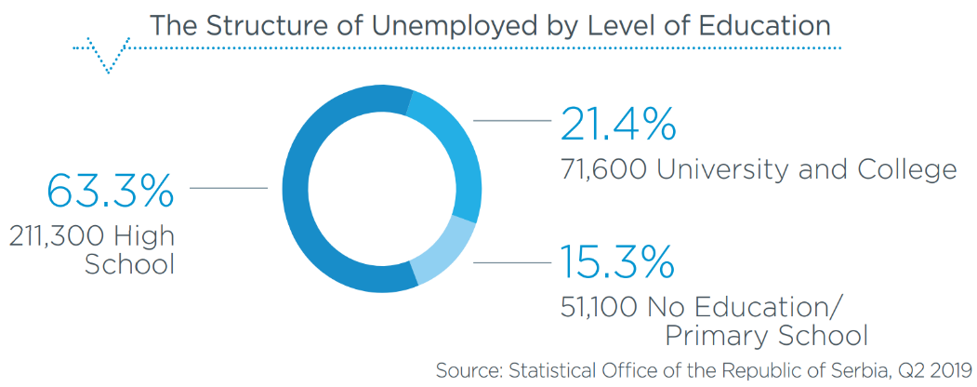
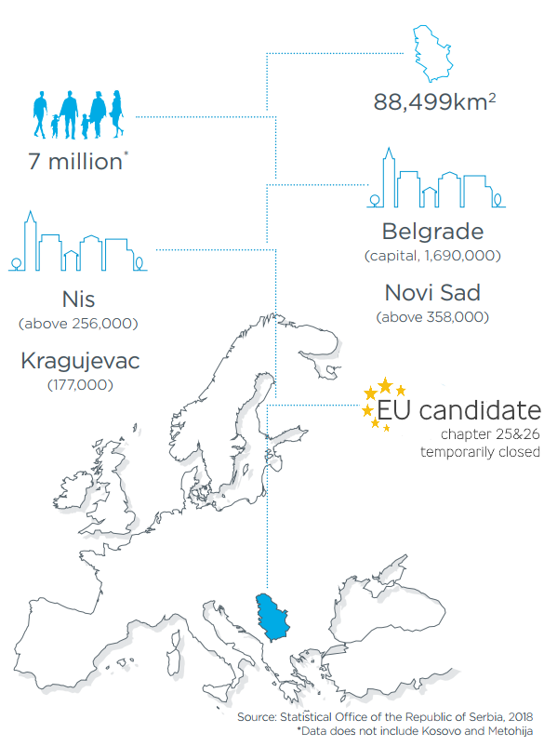
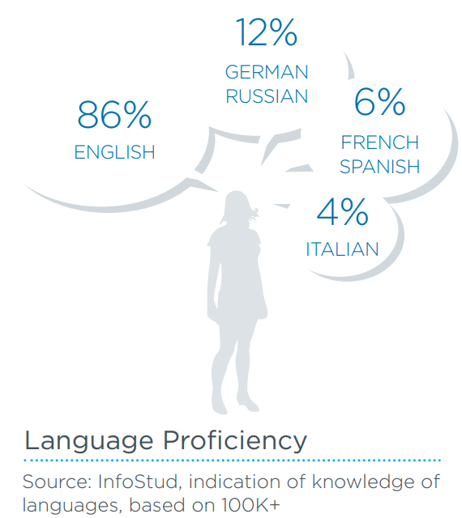

Slide 3
EDUCATION SYSTEM OF THE REPUBLIC OF SERBIA

Slide 4
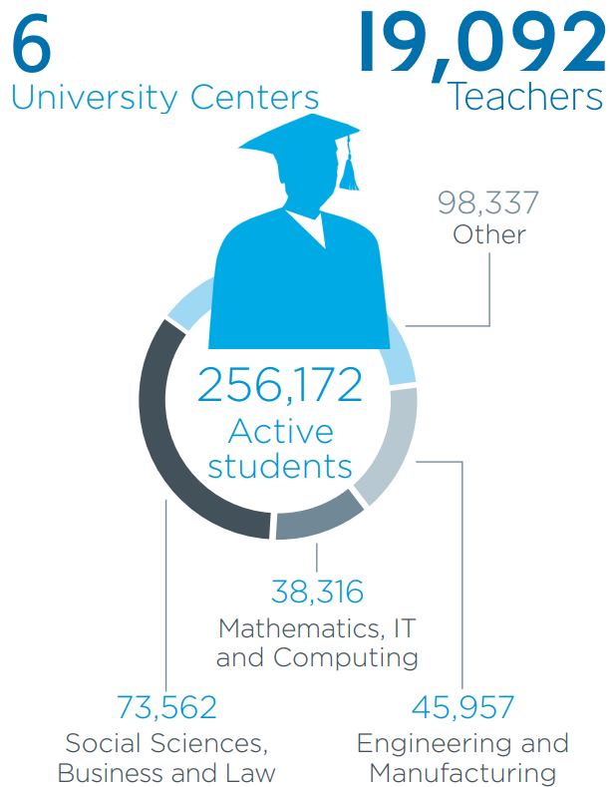
Education system in numbers

Slide 5
ŠEMA

Slide 6
Education system goals
increase in the quality of education processes and outcomes
increase in the coverage of population at all educational levels
achieve and maintain the relevance of education in accordance with the immediate and developmental needs of an individual, economy, social and cultural context
The National Qualifications Framework allows the comprehensive achievement of goals by way of allowing analytical and quality assurance processes in parts of the system to be carried out while having in mind the whole, thus ensuring the coherence of the education system development policy

Slide 7
The institutional framework of the education system
Governing institution | Advisory bodies | Professional institutions
Ministry of Education, Science and Technological Development (MoESTD) | NQFS Council (NQFSC) | Qualifications Agency (QA)
 | National Council for Higher Education (NCHE) | National Entity for Accreditation and Quality Assurance in Higher Education (NEAQA)
 | National Education Council (NEC) | Institute for the Improvement of Education (IIE)
 | Council for Vocational Education and Adult Education (CVETAE) | Instutute for Education Quality and Evaluation (IEQE)
 | 12 Sector Skills Councils (SSC)

Slide 8
Legal framework of the education system
Law on Foundations of the Education System
(„Official Gazette RS“, no .88/17, 27/18 - other law, 27/18 - other law and 10/19)
Law on Preschool Education
(„Official Gazette RS“, no. 18/10, 101/17, 113/17 - other law and 10/19)
Law on Primary Education
(„Official Gazette RS“, no. 55/13, 101/17, 27/18 - other law and 10/19)
Law on Secondary Education
(„Official Gazette RS“, no. 55/13, 101/17 i 27/18 - other law)
Law on Dual Education
(„Official Gazette“, no. 101/17)
Law on Adult Education
(„Official Gazette RS“, no. 55/13, 88/17 - other law and 27/18 - other law)
Law on Higher Education
(„Official Gazette RS“, no. 88/17, 27/18 - other law, 73/18 i 67/19)
Law on the Dual Model of Studies in Higher Education
(„Official Gazette RS“, no. 66/19)
Law on National Qualifications Framework of the Republic of Serbia
(„Official Gazette RS“, no. 27/18)

Slide 9
NATIONAL QUALIFICATIONS FRAMEWORK OF THE REPUBLIC OF SERBIA
Development of NQFS
Qualification levels and descriptors
Qualification standards
NQFS Register
Quality assurance

Slide 10
I phase of the NQFS development
2005.
the process started with the support of EU projects in the area of VET and introduction of the Bologna Process in Higher education
2007.
NQFS implemented in policies – Strategy for Vocational Education Development and Strategy for Adult Education Development
2012.
NQFS implemented in the Strategy for Education Development in Serbia by 2020
2013.
the document National Qualifications Framework – national qualifications system from level 1 to level 5 developed and approved by the Council for Vocational Education and Adult Education
2015.
public hearing at the National Assembly of the Republic of Serbia on the subject “National Qualifications Framework-linking education and labour market in the Republic of Serbia”
Notes:
started with reform process in VET and HE; long process of planning – policy and strategy implementation; in 2013 first document on NQF in VET

Slide 11
II phase of the NQFS development
2015.
The Expert team for the development of an integrated National Qualifications Framework from level 1 to 8 was formed
2017.
National Education Council, Council for Vocational Education and Adult Education and National Council for Higher Education adopted the qualification levels and level descriptors from level 1 to 8
2017.
Council for Vocational Education and Adult Education, National Council for Higher Education, Institute for the Improvement of Education and Chamber of Commerce and Industry adopted the use of International Standard Classification of Education (ISCED 2013f ) in NQFS
2017.
Qualifications database established (http://noks.mpn.gov.rs)
Notes:
operative phase – development of integrated NQFS base don the proposals from VET and HE frameworks.

Slide 12
2017.
Inter-ministerial Working Group for the Establishment and Implementation of NQFS formed, consisting of the representatives of:
Ministry of Education, Science and Technological Development | Ministry of Labour, Employment, Veteran and Social Affairs
Ministry of Finance | Ministry of Public Administration and Local Self-Government
Ministry of Justice | Ministry of Youth and Sport
Chamber of Commerce and Industry of Serbia | Institute for the Improvement of Education
Institute for Education Quality and Evaluation | National Employment Service
Public Policy Secretariat of the Republic of Serbia | National Council for Higher Education
Serbian Association of Employers | Statistical Office of the Republic of Serbia
National Education Council | Council for Vocational Education and Adult Education
Commission for Accreditation and Quality Assurance (National Entity for Accreditation and Quality Assurance in Higher Education ) | Conference of Universities
Conference of Academies for Applied Studies in Serbia | United Branch Trade Unions “Nezavisnost”
Confederation of Autonomous Trade Unions of Serbia

Slide 13
III phase of the NQFS development
2018.
Law on NQFS adopted („Official Gazette“ no. 27/18)
2018.
establishment of institutions – Qualifications Agency, NQFS Council, and 12 Sector Skills Councils
2019.
Working Group for referencing the NQFS to the EQF and QF-EHEA
2019.
Activity plan for the process of referencing the NQFS to the EQF and QF-EHEA

Slide 14
NQFS– levels
NQFS level | NQFS sublevel | Qualifications | EQF level
1 | - | Primary education Primary adult education Primary music education Primary ballet education | 1
2 | - | Vocational training (up to 1 year) Education for work (up to 2 years) Non-formal adult education(120 - 360 hours) | 2
3 | - | Secondary vocational education (3 years) Non-formal adult education (min 960 hours) | 3
4 | - | Secondary education (vocational, arts, gymnasium) (4 years) | 4
5 | - | “Meister” craftsman education, specialist education (1 - 2 years) Non-formal adult education (min 6 months) | 5
6 | 6.1 | Undergraduate (Bachelor) academic studies (min 180 ECTS) Undergraduate (bachelor) applied studies (180 ECTS) | 6
 | 6.2 | Undergraduate (Bachelor with honors) academic studies (min 240 ECTS), Specialized applied studies (min 60 ECTS)
7 | 7.1 | Integrated academic studies (300 do 360 ECTS) Master academic studies (min 60 ECTS) – with previously completed undergraduate (bachelor with honors) academic studies (min 240 ECTS) Master academic studies (min 120 ECTS) - with previously completed undergarduate (bachelor) academic studies (180 ECTS) Master applied studies (min 120ECTS) - with previously completed undergarduate (bachelor) applied studies (180 ECTS) | 7
 | 7.2 | Specialized academic studies (min 60ECTS) - with previously completed master academic studies
8 | - | Doctoral studies (180 ECTS) – with previously completed integrated academic, or master academic studies | 8
Notes:
The Integrated National Qualifications Framework in Serbia has eight (8) levels with 4 sublevels. The architecture of the NQFS and EQF is to the greatest extent identical at all levels, apart from the fact that in the NQFS levels 6 and 7 have two sublevels. two reasons: terminology- titles: tradition – professional qualifications and degree/salaries.
The WG has analysed the statements of learning outcomes in NQFS and EQF and has reached the conclusion that NQF levels 1-5 essentially correspond to EQF levels of the same category, whereas the levels 5-8 with their corresponding sublevels could be related to EQF 5- 8 levels, taking into account the significance of the learning outcomes they are based on.

Slide 15
Types of qualifications
TYPE | NQFS LEVEL | FORM OF EDUCATION/LEARNING | QUALIFICATION TITLE
GENERAL | NQFS 1 | FORMAL | PRIMARY EDUCATION (TWO CYCLES, 8 YEARS)
 | NQFS 4 | FORMAL | GYMNASIUM (4 YEARS)
VOCATIONAL | NQFS 2 | FORMAL / NON-FORMAL | MANIPULATOR IN FOOD PRODUCTION (2 YEARS)
 | NQFS 3 | FORMAL / NON-FORMAL | BAKER (3 YEARS)
 | NQFS 4 | FORMAL | FOOD PROCESSING TECHNICIAN (4 YEARS)
 | NQFS 5 | FORMAL / NON-FORMAL | BAKER – SPECIALIST (1 YEAR)
ACADEMIC | NQFS 6.1 | FORMAL | AGRICULTURAL ENGINEER (180 ECTS)
 | NQFS 6.2 | FORMAL | GRADUATED AGRICULTURAL ENGINEER (240 ECTS)
 | NQFS 7.1 | FORMAL | MASTER AGRICULTURAL ENGINEER (60 ECTS)
 | NQFS 7.2 | FORMAL | SPECIALIST AGRICULTURAL ENGINEER (60 ECTS)
 | NQFS S 8 | FORMAL | PHD – BIOTECHNICAL SCIENCES (180 ECTS)
PROFESSIONAL | NQFS 6.1 | FORMAL | PROFESSIONAL AGRICULTURAL ENGINEER (180 ECTS)
 | NQFS 6.2 | FORMAL | PROFESSIONAL SPECIALIST AGRICULTURAL ENGINEER (60 ECTS)
 | NQFS 7.1 | FORMAL | PROFESSIONAL MASTER AGRICULTURAL ENGINEER (120 ECTS)
Notes:
In the Republic of Serbia, a comprehensive, integrated national qualifications framework has been established to cover all levels and types of qualifications, regardless of the way they are acquired (through formal or non-formal education, or informal learning – (life or work experience) and the age at which they are acquired ( young or adult);the clarity of their interconnection

Slide 16
Key concepts in NQFS
Concept of competency-based education
Concept of learning outcomes
Key competences
Standards of achievement and examination
Curriculum standards
Qualification standards
Notes:
Anchoring of learning outcomes based thinking in national curricula ‚Paradigm shift towards learning outcomes‘, development and implementation of competence based teaching and learning
The first describes the qualification for a given level of study, respecting the Dublin Learning Outcome Descriptors for a given level of study. Second, referring to the study program, describe the outcome of the learning process as a compulsory element of the program, as well as the general and subject-specific competencies of graduates of a particular study program. It is laid down in Article 38 of the Law on Higher Education that a study programme shall determine learning outcomes in accordance with the law stipulated by the National Qualifications Framework. Standard 4 for the Accreditation of Higher Education Institutions defines knowledge, skills, abilities and attitudes descriptors for each level of higher education in alignment with the Dublin descriptors. Standard 4 for the accreditation of study programmes defines that by successfully completing a specific study programme, a student acquires relevant knowledge, skills, abilities and attitudes in accordance with the NQFS descriptors. The development of education/training programmes based on qualifications and learning outcomes standards enhances the quality of the learning process and mechanisms for monitoring, evaluation/validation of acquired knowledge and skills, i.e. competences.

Slide 17
Level descriptors
Notes:
Qualifications in the NQFS are sorted by complexity at levels and sublevels using level descriptors. In the NQFS, descriptions of knowledge, skills, abilities and attitudes statements, necessary for the job or further learning, are determined for each (sub) level of qualifications.

Slide 18
Level descriptors
Level | KNOWLEDGE | SKILLS | ABILITIES AND ATTITUDES
 | Person with the acquired level of qualification:
2. | Possesses general and vocational knowledge of the facts and basic principles required for work and / or learning | Uses the skills required to perform less complex, pre-determined operational tasks; Handles tools and machines with detailed technical instructions using prescribed materials for work | Performs tasks in accordance with the established technical and technological procedures, with periodic supervision; Is responsible for the use of established procedures, resources and organization of his own work
6.2 | Possess advanced academic and / or professional knowledge related to theories, principles and processes including evaluation, critical understanding and application in the field of learning and / or work | Solves complex problems in the field of learning and / or work in non-standard settings; Applies successful communication skills in interaction and collaboration with others from different social groups; Uses equipment, instruments and devices relevant to the field of learning and / or work | Is enterprsing in solving problems under non-standard circumstances; Runs complex projects independently and with full responsibility; Applies the ethical standards of his profession; Organizes, controls, and trains others for work; Analyses and evaluates different concepts, models and principles of theory and practice thus advancing existing practice; Expresses a positive attitude towards the importance of lifelong learning in personal and professional development
Notes:
elaboration

Slide 19
Credit System
ECTS is based on the principle that the sum of 60 ECTS points corresponds to the overall average student engagement during a 40-hour workweek in an academic year.
Student workload - about 1500-1800 hours per year - 1 ECTS credit is awarded for about 25-30 working hours.
The student workload expressed through ECTS credits implies the time required to complete learning activities: attending classes, seminars, consultations, independent research and learning, project preparation, exams, practical classes, etc.
Transfer of ECTS credits is possible between different study programs, within the same cycle and type of studies, while in international mobility programmes transfer of ECTS credits is possible also between different cycles and types of studies
Implementation of the system ECVET is foreseen in the Strategy, but neither decision nor regulation has been adopted.

Slide 20
Qualification standard
Qualification standard is a document established at the national level that contains reference data set on qualification, based on which its classification, levelling and evaluation is carried out.
Statement of purpose
They are developed for all types and levels, ensuring the transparency and coherence of the entire qualifications system and comparability at the national and international context.
Data from education are linked to the labour market data, making the qualifications system relevant to meeting the needs of society and an individual.
The availability of data relevant to the content of qualification and its purpose to each individual contributes to the understanding and application of the concept of lifelong learning, the development of career management skills.
The quality development and quality validation of all elements of the education / training programmes are based on qualification standard.
A set of quality assurance mechanisms at the level of the education / training providers / organizers is developed in respect to the learning outcomes established by the qualification standard.
Quality assurance for the assessment of achievement - assigning a national qualification (examination processes and criteria for the leaning outcomes assessment) is based on qualification standard
Notes:
national document, defined by the Law, methodology of development and procedure of adoption, institutions and bodies included, the whole process of planning, development, implementation and evaluation is QA. Learning outcomes are central elements

Slide 21
Qualification standard elements
QUALIFICATION STANDARD
Title of the qualification:
Code of the qualification
BASIC QUALIFICATION CHARACTERISTICS | RELEVANCE OF QUALIFICATION FOR EMPLOYMENT AND FURTHER LEARNING
CLASSNQFS / ISCED-F 2013 | Permeability within the qualifications system
NQFS LEVEL | Occupation(s) to which qualification is related
EQF level | Occupational standard^{[1]}
QF-EHEA cycle | Duties and tasks
Type of the qualification | LEARNING OUTCOMES
Scope of the qualification | General description of the qualification
Preconditions for the acquisition of the qualification | Knowledge
Form of learning/education | Skills
Type of public document | Abilities and attitudes
 | Type of assessment of the achievement of learning outcomes
QUALIFICATION STANDARD REFERENCE DATA | QUALIFICATION QUALITY ASSURANCE
Effective Date | Qualifications of programme organizers
Revision date | The body competent for issuing the document
End date
^{[1]} Article 50. paragraph 3. of the Law on NQFS stipulates that until the adoption of occupational standards in accordance with the regulations relevant to employment, the link between qualification standards and the labour market will be based on the data on occupations determined in accordance with labour and employment regulations.
Notes:
5 groups of data, established in standardized format and structure

Slide 22
NQFS Register
NQFS Register is a public database in which qualifications are classified and which contains relevant information on qualifications.
Role of the NQFS Register :
transparent integration of the data on nationally recognized qualifications at all levels
comparability of learning outcomes achieved at different levels, within different types and different forms of learning
linking data on qualifications to occupations
comparability of qualification levels in Serbia with EQF and QF-EHEA levels
Notes:
Qualifications regulated by the NQFS are nationally recognized and recorded in the NQFS Register.

Slide 23
NQFS Register structure
NQFS Register consists of sub-registers:
National Qualifications - contains information on the qualifications acquired before and after the establishment of the NQFS Register classified by level and type in accordance with the CLASSNQFS (classification system)
Qualification standards - contains information on the qualification standards (type and level of qualifications according to NQFS and EQF and QF-EHEA, learning outcomes, link with occupations, method of acquisition ...)
Publicly Recognized Organizers of Adult Education Activities (PROAEA) - Information on PROAEA that have been accredited or revoked approvals for work, approved adult education programs/activities and employers with whom PROAEA realize practical work.

Slide 24
Managing NQFS Register
Qualifications Agency manages NQFS Register.
NQFS Register will exchange data with the Integrated Education Information System managed by the Ministry of Education, Science and Technological Development.
NQFS Register will be managed electronically both in Serbian and English language.
The NQFS Register is being established with the support of the IPA 2014 „The development of an integrated National Qualifications System in Serbia“

Slide 25
Quality assurance in General/VET Education
STANDARD | PROCESS | COMPETENT INSTITUTIONS/ BODIES
qualification | development and adoption of qualification standards | Qualifications Agency Sector skills council NQFS Council Ministry of Education, Science and Technological Development
programmes | programme accreditation | National Education Council The Council for VET and Adult Education Ministry of Education, Science and Technological Development
institutions | verification of the institution | Ministry of Education, Science and Technological Development
pupils achievements/ certification | school grading final and matura exam national testing | School Institute for Education Quality and Evaluation Institute for the Improvement of Education Ministry of Education, Science and Technological Development
Quality of work of the institution | external evaluation self-evaluation | Ministry of Education, Science and Technological Development/ Institute for Education Quality and Evaluation School
Notes:
NQFS covers the processes and institutions (bodies, organizations) responsible for determining qualifications and standards of qualifications, ways and conditions for acquiring, comparing and recognizing qualifications, as well as other mechanisms for quality assurance.

Slide 26
Quality assurance in Adult Education
STANDARD | PROCESS | COMPETENT INSTITUTIONS/ BODIES
qualification | development and adoption of qualification standards | Qualifications Agency Sector skills council NQFS Council Ministry of Education, Science and Technological Development
programmes | PROAEA status approval– programme and provider | Ministry of Education, Science and Technological Development / Qualifications Agency
trainees achievements/ certification | exam grading | PROAEA
Quality of work of the institution | external evaluation self-evaluation | Qualifications Agency PROAEA

Slide 27
Quality assurance in Higher Education
STANDARD | PROCESS | COMPETENT INSTITUTIONS/ BODIES
qualification | development and adoption of qualification standards | Qualifications Agency Sector skills council NQFS Council Ministry of Education, Science and Technological Development
programmes | accreditation of programmes and higher education institutions issuing a work permit | National Council for Higher Education (standards) National Entity for Accreditation and Quality Assurance Ministry of Education, Science and Technological Development
student achievements/ certification | grading final thesis | Higher education institution
Quality of work of the institution | external evaluation self-evaluation | National Entity for Accreditation and Quality Assurance Higher education institution

Slide 28
REFERENCING PROCESS
Notes:
Serbia started with preparation process for referencing at the end of 2016, and in 2017 Inter - ministerial group adopted document NQFS as the basis for establish Law and referencing process, in 2018 Ministry as NCP took over management of Referencing process. Plan of Activities was developed and National WG for Referencing NQFS to EQF was form.

Slide 29
International Experts
Prof. Mile Dželalija, PhD from Croatia – member of the EQF Advisory Group of the European Commission, National Correspondents for the QF-EHEA of the Council of Europe, Cross-sectoral Reference Group of the ESCO etc, participated in referencing national frameworks to EQF (Croatia, Greece, Montenegro, Turkey, North Macedonia, Bosnia and Herzegovina)
Eduard Staudecker form Austria, member of the EQF Advisory Group of the European Commission, European EUROPASS Advisory Group, Advisory Committee for Vocational education and training, the CEDEFOP governing board and member of the ECVET users group at European level etc, participated in referencing national frameworks to EQF (Poland, Luxembourg, Croatia, Finland, Montenegro, Liechtenstein, Bosnia and Herzegovina, North Macedonia)
Providing expert support in the preparation of the Report on referencing the NQFS to the EQF and in applying methodological guidelines for conducting the process of comparing and referencing national frameworks to the EQF
Holding working meetings and workshops with national experts
Preparing comments and recommendations on the Draft Report on Referencing the NQF to the EQF
Giving final assessment of the Referencing Report

Slide 30
Referencing and self-certification report
Draft Report structure:
Description of the education system
National Qualification Framework of the Republic of Serbia
Referencing NQFS and self-certification to the EQF and QF-EHEA
Future challenges regarding the integration and implementation of NQFS
http://noks.mpn.gov.rs/
The ongoing activities include the consultation process, analysis of future challenges and gathering approvals of key stakeholders.
The final document is expected to be published on the website of the Government of the Republic of Serbia by the end of 2019.

Slide 31
Referencing process
Activities that have been carried out | Further activities
A working group was formed to produce the Report in accordance with the Action Plan of the Inter-Ministerial Working Group | Analysis and harmonization of the oppinions of key quality assurance institutions
Brochure on referencing criteria based on the EU Guidelines was prepared | Presentations – Inter-ministerial Working Group, NQFS Council and Sector Skills Councils
Plan for carrying out the referencing process was adopted by the Minister | Integration of the consultation results and proposals for further activities and challenges into the Report
Data for the Report collected - analysis of documentation and consultations with MoESTD, QA, councils, institutes | Forwarding the Draft Report to the Council of Europe
Expert support (meetings and workshops), consultations with ETF | Presenting the Draft Report and referencing process at the Conference on NQFS in December 2019
Comments from relevant departments of the MoESTD collected | Finalizing the Report
Draft Referencing report prepared | Final evaluation by international experts
Delegation to present the first Draft Report nominated | Presenting the Report to the Advisory Group (FEBRUARY 2020)
Draft Report sent to key quality assurance institutions for their opinion (QA, IIE, IEQE, NEAQA) | Updating websites, promotion of the Report
 | Planning and initiation of activities in the system as a consequence of referencing NQFS to the EQF

Slide 32
Thank you for your attention!
http://noks.mpn.gov.rs

